Slide 1
Week 10
Alexey V. Zimin
JHU BME 580.417/707

Slide 2
Evaluating transcript assembly
We want to compare the assembly output against a benchmark transcriptome where correct sequences of all transcripts are known.
Limitations of using a known reference transcriptome:
variability in the transcriptome (e.g. among e.g. cell types) makes it impossible to determine whether sequences from the reference that are missing from the assembled transcriptome are due to assembly errors, or whether they were not expressed in the library sequenced
transcriptome sequences may also vary between the individual under study and the reference

Slide 3


Common reference annotation databases
GENCODE annotation is made by merging the manual gene annotation produced by Ensembl-Havana team with the Ensembl-genebuild automated annotation
  Generally more permissive, contains more transcripts, incomplete protein coding genes
  Human annotation contains over 600,000 transcripts
RefSeq annotation is produced, curated and hosted by NCBI
  More conservative, only complete proteins
  Human annotation contains about 200,000 transcripts
CHESS annotation is built at JHU from >20000 RNA-seq (GTEx) data sets, highly curated, some RefSeq transcripts are imported
  Human annotation contains about 141,000 transcripts

Slide 4
Evaluating agains the reference
REMEMBER: there is no single complete reference (even human annotation is not perfect):
  If assembled transcript matches the reference, it is most likely correct
  If assembled transcript does not match the reference, it may be correct
  Transcript may match one reference version but not the other

Slide 5
Benchmark transcriptome
We don’t have RNA-seq data from a transcriptome where all transcript sequences and expression patterns are known => can simulate the sequencing of a given benchmark transcriptome to comprehensively assess all assembly errors.
Tools that can generate simulated reads modeling the errors and biases introduced by
  short Illumina RNA-seq reads: RSEM, FluxSimulator, Polyester
  long transcriptome sequencing reads: PBSIM, Trans-NanoSim
Simulated data can only be used to test the validity of an algorithm – it is a necessary, but not sufficient performance criteria

Slide 6
Benchmark transcriptome
Compare to the reference
P – positive
N – negative
☺ TP – True Positive, we found correct transcript
☺ TN – True Negative, we did not find transcript where there was none
☹ FP – False Positive, we found transcript where there was none
☹ FN – False Negative, we missed transcript
P = TP + FN
N = TN + FP

Slide 7
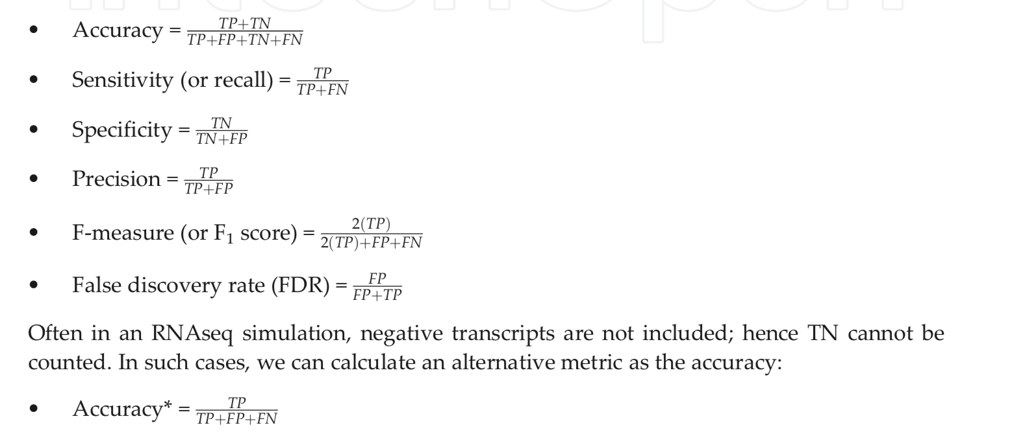
Assembly metrics based on benchmark
P = TP + FN
N = TN + FP

Slide 8
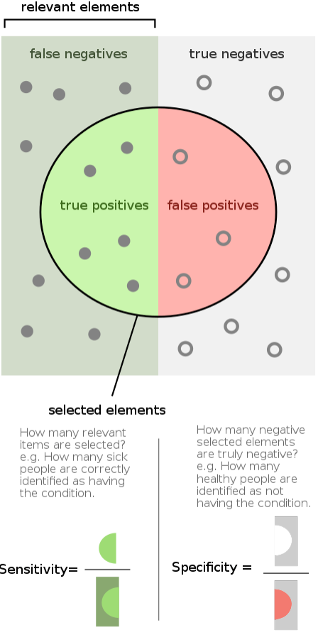
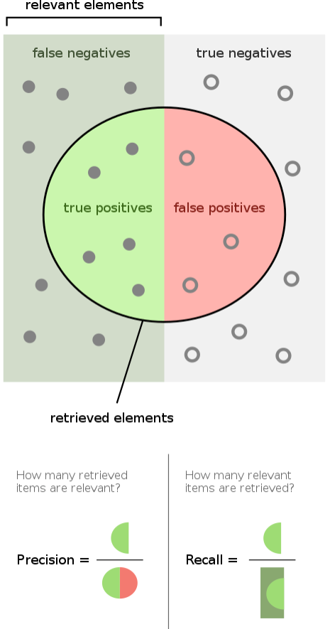
Measures of correctness
Sensitivity (Recall), Specificity
and Precision
Image credit: Wikipedia

Slide 9
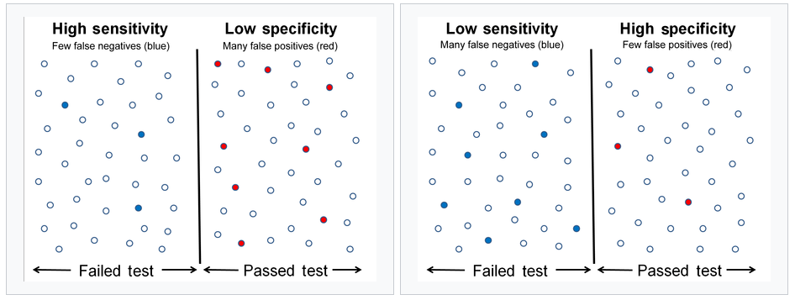
Sensitivity and Specificity

Slide 10
Intron chain
Intron chain is the set of numbers corresponding to the start and end exon coordinates for spliced exons
Intron chain also records the strand (+, or forward) or (-, or reverse)
Intron chain here is (+) i₁, i₂, i₃, i₄, i₅, i₆
Ignores start and end coordinates
Coding start
Coding stop
i₁
i₂
i₃
i₄
i₅
i₆

Slide 11
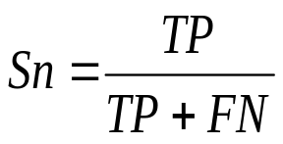
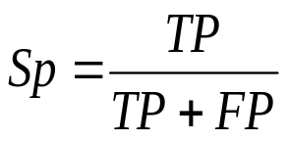
Nucleotide(Base) level accuracy
TN
FN
TP
FP
TN
FN
TP
FN
TN
REALITY
ASSEMBLY
Sensitivity:
Precision:

Slide 12
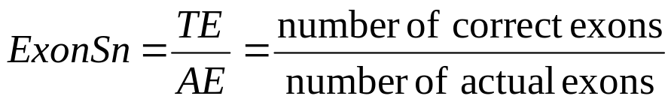
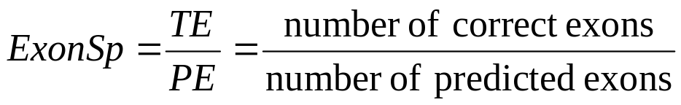
Exon level accuracy
WRONG
EXON
CORRECT
EXON
MISSING
EXON
REALITY
ASSEMBLY
Exon Sensitivity
Exon Precision
“Junction ends” must match exactly, beginning or end do not!

Slide 13
Transcript level accuracy
< 80%
REALITY
(two transcripts)
ASSEMBLY
(four transcripts)
WRONG!
Same INTRON CHAIN => CORRECT!
Intron coordinates must match EXACTLY, beginning and end do not have to match for multi-exon transcripts
CORRECT!

Slide 14
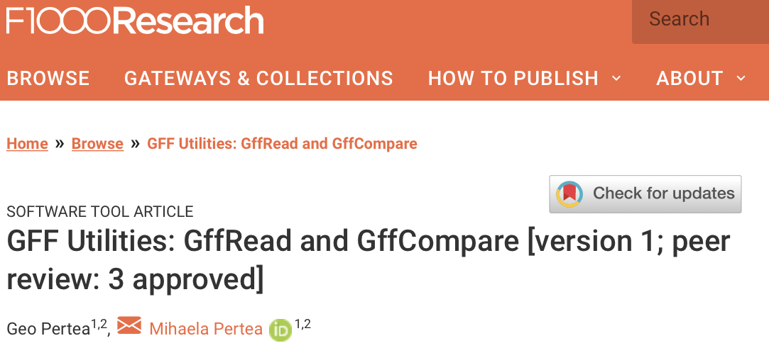
gffread, gffcompare and trmap
gffread, gffcompare and trmap
- a fast tool for verification, filtering and conversion of the most popular annotation file formats (GTF, GFF3, BED) and for quick extraction of transcript sequences from the genome sequence.
FASTA:
GFF/BED:
gffread -w
http://ccb.jhu.edu/software/stringtie/gff.shtml

Slide 15
gffread, gffcompare and trmap
gffread, gffcompare and trmap
- a tool for merging and tracking transcript structures across multiple samples and comparing them to a reference annotation.
exon 1
exon 2
exon 3
exon 4
Reference
transcripts
isoform 1
isoform 2
Sample 1
transfrags
Sample 2
transfrags
Merged
transcripts
http://ccb.jhu.edu/software/stringtie/gff.shtml

Slide 16
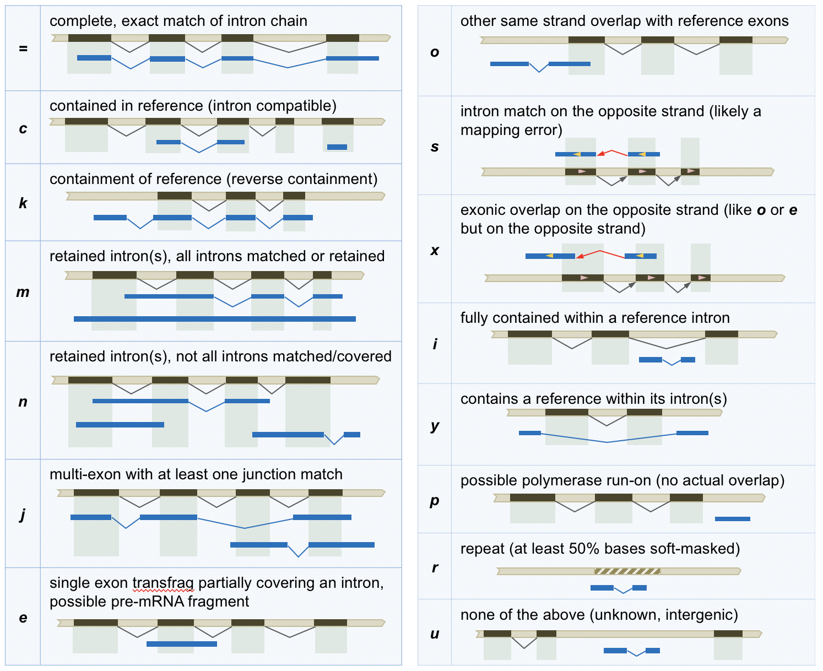
gffread, gffcompare and trmap
gffread, gffcompare and trmap
- a tool for merging and tracking transcript structures across multiple samples and comparing them to a reference annotation.
http://ccb.jhu.edu/software/stringtie/gff.shtml

Slide 17
gffread, gffcompare and trmap
gffread, gffcompare and trmap
- designed for large scale overlap analysis of streaming transcript prediction data (millions of transcripts) with a reference annotation data set; it performs detection and classification of all the overlaps found between the streamed transcripts and the reference annotation transcripts.
http://ccb.jhu.edu/software/stringtie/gff.shtml

Slide 18
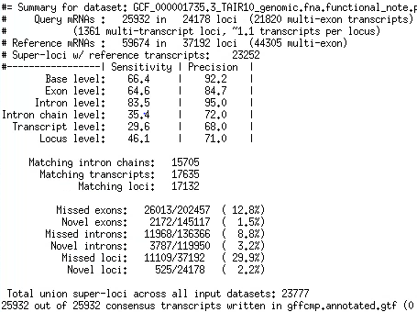
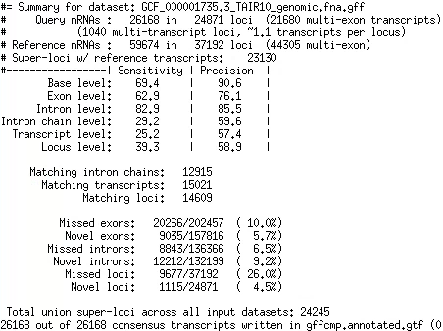
gffcompare of two annotations

Slide 19
gffcompare of two annotations

Slide 20
Evaluating agains the reference
REMEMBER: there is no complete reference (even human annotation is not perfect):
  If assembled transcript matches the reference, it is most likely correct
  If assembled transcript does not match the reference, it may be correct
In comparisons prioritize Sensitivity!
  If the F1 score is the same for two assemblies, the one with higher Sensitivity is better!

Slide 21
Errors in transcript assemblies and how to mitigate them
Assemblies of individual transcriptome (e.g. RNA-seq) data sets are:
  Incomplete
  Have noisy transcripts
  Have erroneously assembled transcripts
We can improve by sequencing multiple samples from (ideally) multiple tissues
  Helps with completeness (+Sensitivity)
  Increases transcriptional noise (-Precision)
  Increases assembly errors (-Precision)

Slide 22
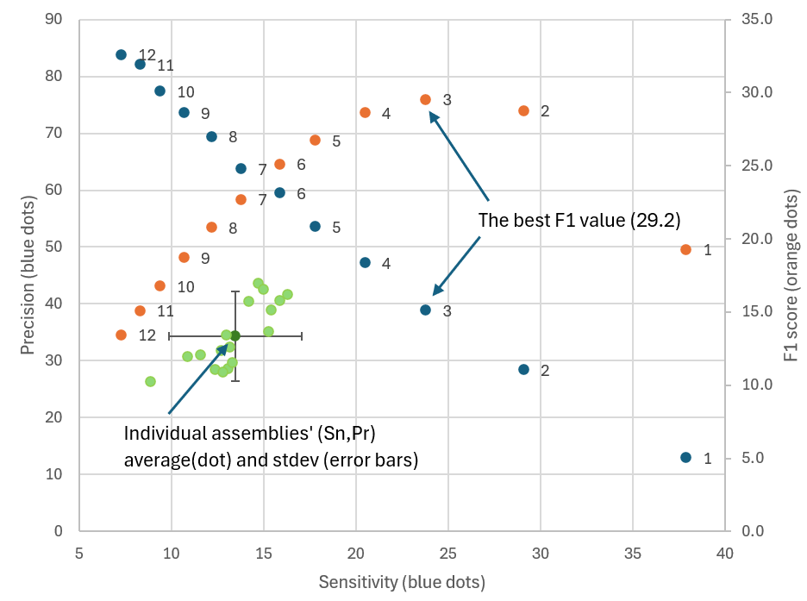
Errors in transcript assemblies and how to mitigate them
Example: human transcript assembly from 17 tissues/samples:
  Assemble each sample individually
  Merge assemblies from N samples
  Compare to RefSeq annotation
  Using data from more tissues: higher Sn, lower Pr
  The best F1 value is achieved by keeping transcripts that are present is 2-3+ samples

